Slide 1

2026 Leadership Day
Protect and Invest in Primary Care and Physician Workforce
May 12, 2026
Jared Frost, Manager, Legislative Affairs and PAC
Notes:
Hello, everyone. Thank you for participating in Leadership Day 2026. My name is Jared Frost and I’m a Manager in ACP’s Legislative Affairs department in the Washington, DC office. My colleagues and I are often on Capitol Hill advocating for ACP members and their health policy priorities. But the difference at Leadership Day is that you—as an internal medicine physician and not a lobbyist—get to speak in a unified voice to help advance internal medicine and to help your patients. Today I’m going to briefly talk about the issue brief, “Protect and Invest in Primary Care and Physician Workforce” to help prepare you for your Hill visits.

Slide 2
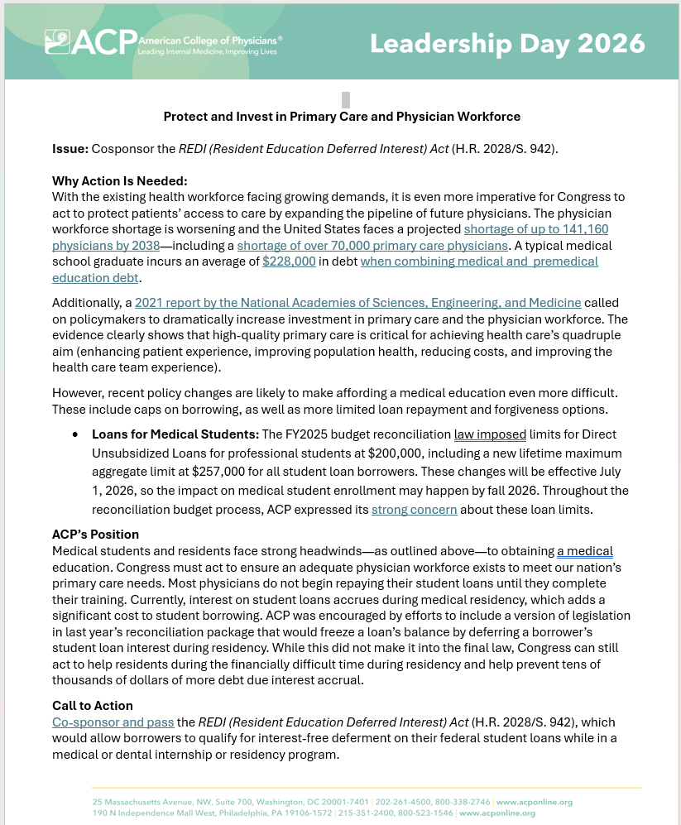
Notes:
Here is the Issue brief for “PLACEHOLDER Health Workforce” that you will use to advocate for ACP’s priorities when you make your visits on Capitol Hill. As we will see, it has a brief description of the issue and at the bottom it lists what we will call the “ask”. Admittedly, this topic can be challenging because the “ask”—deferring student loan interest during residency—is just a small part in a landscape that has gotten worse in the last year.. What is most vital is that you relay your personal experience with attending and paying for medical school and how less physicians overall will impact practice of medicine and the overall health and well being of your patients.

Slide 3
Protect and Invest in Primary Care and Physician Workforce
What’s it all about?
  Congress needs to protect and invest in our nation’s health workforce—especially the physician workforce. Better access to physicians improves our country’s health and wellbeing.
  According to the Health Services and Resources Administration (HRSA), the United States faces a projected shortage of up to 141,160 physicians by 2038—including a shortage of over 70,000 primary care physicians.
  A 2021 report by the National Academies of Sciences, Engineering, and Medicine called on policymakers to dramatically increase investment in primary care and the physician workforce. The evidence clearly shows that high-quality primary care is critical for achieving health care’s quadruple aim (enhancing patient experience, improving population health, reducing costs, and improving the health care team experience).
  Recent actions by the administration and Congress have made affording a medical education more difficult by limiting loan repayment and forgiveness options and increasing barriers in recruiting international medical graduates (IMGs) who help fill critical workforce gaps.
Notes:
As you well know firsthand, internal medicine physicians and their practices have experienced immense stress over the last few years, whether from inadequate payment, administrative burden, or just from a lack of enough physicians, especially primary care specialists.
The evidence is clear that we’re facing a physician shortage. Recent physician workforce projections show that we anticipate an overall shortage of physicians as well as that of primary care, over 70,000.
A physician workforce shortage isn’t the only headwind that internal medicine faces—both the administration and Congress have created new challenges for medical profession.

Slide 4
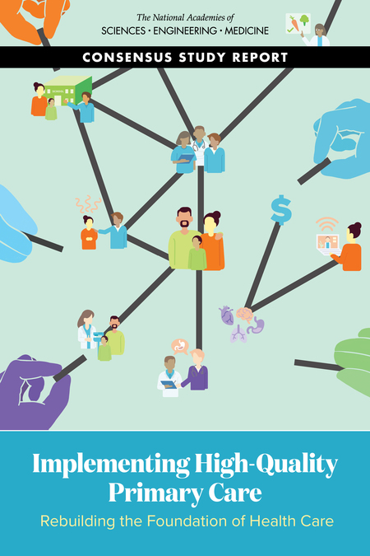
Protect and Invest in Primary Care and Physician Workforce
Implementing High-Quality Primary Care
Rebuilding the Foundation of Health Care
This 2021 report by the National Academies of Sciences, Engineering and Medicine (NASEM) called on policymakers to increase investment in primary care as evidence shows that it is critical for achieving health care’s quadruple aim (enhancing patient experience, improving population, reducing costs, and improving the health care team experience).
Notes:
We have the evidence. A 2021 report by the National Academies of Sciences, Engineering and Medicine (NASEM) clearly stated “that the evidence shows that increasing the proportion of primary care physicians in the total physician workforce has numerous benefits, including increasing quality and access to care.
The report also calls for GME policy to increase the proportion of GME funding dedicated towards primary care workforce training. More residency slots would be needed to achieve this goal.
ACP strongly supports the Resident Physician Shortage Reduction Act, which would provide an additional 14,000 residency slots over seven years. ACP has also called for residency slots to be specifically allotted towards primary care.

Slide 5
Protect and Invest in Primary Care and Physician Workforce
Student Loans for Medical Students:
The FY2025 budget reconciliation law eliminated GradPLUS Loans for professional students. It also imposed limits for Direct Unsubsidized Loans for professional students at $200,000, including a new lifetime maximum aggregate limit at $257,500 for all student loan borrowers.
These changes will be effective July 1, 2026, so the impact on medical student enrollment may happen by fall 2026. Throughout the reconciliation budget process, ACP expressed its strong concern about these loan limits. A typical medical school graduate incurs an average of $228,000 in debt when combined with premedical education debt.
These new loan limits are unrealistic for those pursuing careers in medicine and must be increased.
Notes:
With last year’s FY2025 budget reconciliation law, or One Big Beautiful Bill, or OB3, the GradPLUS program was eliminated. Many medical students used it pay for the full cost of attendance minus any other financial assistance they received, so in many cases, GradPLUS made up the difference.
The cost of medical school typically exceeds the new $50,000 per year and $200,000 lifetime borrowing limit.
A likely result these stricter borrowing limits is an increase in the number of medical students borrowing private student loans. While these loans are generally available up to the cost of attendance, they have some downsides like higher interest rates and requiring good or excellent credit scores.

Slide 6
Protect and Invest in Primary Care and Physician Workforce
Call to Action: The “ASK” – Defer Student Loan Interest during Residency:
Co-sponsor and pass the REDI (Resident Education Deferred Interest) Act (H.R. 2028/S. 942), which would allow borrowers to qualify for interest-free deferment on their federal student loans while in a medical or dental internship or residency program.
In the U.S. House of Representative, the H.R. 2028 was introduced by Rep. Brian Babin (R-TX-36) and Rep. Chrissy Houlahan (D-PA-06). In the U.S. Senate, S. 942 was introduced by Sen. John Boozman (R-AR) and Sen. Jacky Rosen (D-NV).
Defer student-loan interest during residency: Currently, interest on student loans accrues during medical residency, which adds a significant cost to student borrowing. Congress can still act to help residents during the financially difficult time during residency and help prevent tens of thousands of dollars of more debt due interest accrual.
Notes:
Medical students and residents face strong headwinds—as outlined above—to obtaining a medical education. Congress must act to ensure an adequate physician workforce exists to meet our nation’s primary care needs. Most physicians do not begin repaying their student loans until they complete their training.
So what can we ask Congress to do? We can ask them to make it a little bit easier to pay for a medical education. The REDI Act is bipartisan bill allowing medical and dental residents to pause federal student loan payments and, most crucially, stop interest from accruing during their training. It helps relieve the financial strain of high-interest debt on medical trainees with low salaries and helps address the national doctor shortage by making the profession more accessible, including primary care.
ACP was encouraged by efforts to include a version of legislation in last year’s reconciliation package that would freeze a loan’s balance by deferring a borrower’s student loan interest during residency. While this did not make it into the final law, Congress can still act to do so by the end of the session. There is some indication that this bill might be acted upon this session. It’s only chatter at this point, but we’re hopeful that with ACP’s advocacy and the advocacy of other stakeholders, that the bill will move forward.

Slide 7
Protect and Invest in Primary Care and Physician Workforce
To recap the “ASK” of the Call to Action:
  Ask your House member or Senator to support the REDI (Resident Education Deferred Interest) Act (H.R. 2028/S. 942) by cosponsoring it.
  If they are already a cosponsor, ask your House member or Senator to support the passage of these bills before the end of the 119th Congress.
  You can check to see if your House member or Senator is already a cosponsor of these bills by going to Congress.gov to find the list of current cosponsors.
Notes:
So just to review. We have one legislative “ASK” for Protect and Invest in Primary Care and Physician Workforce, cosponsor the REDI Act.
If your House member or Senator already a cosponsor, then that’s great! Please ask them to pass these bills before the end of 2026.

Slide 8
Thank you!
We look forward to your questions.
Notes:
Thank you for your attention. We look forward to answering your questions! And good luck at Leadership Day 2026.

