Slide 1

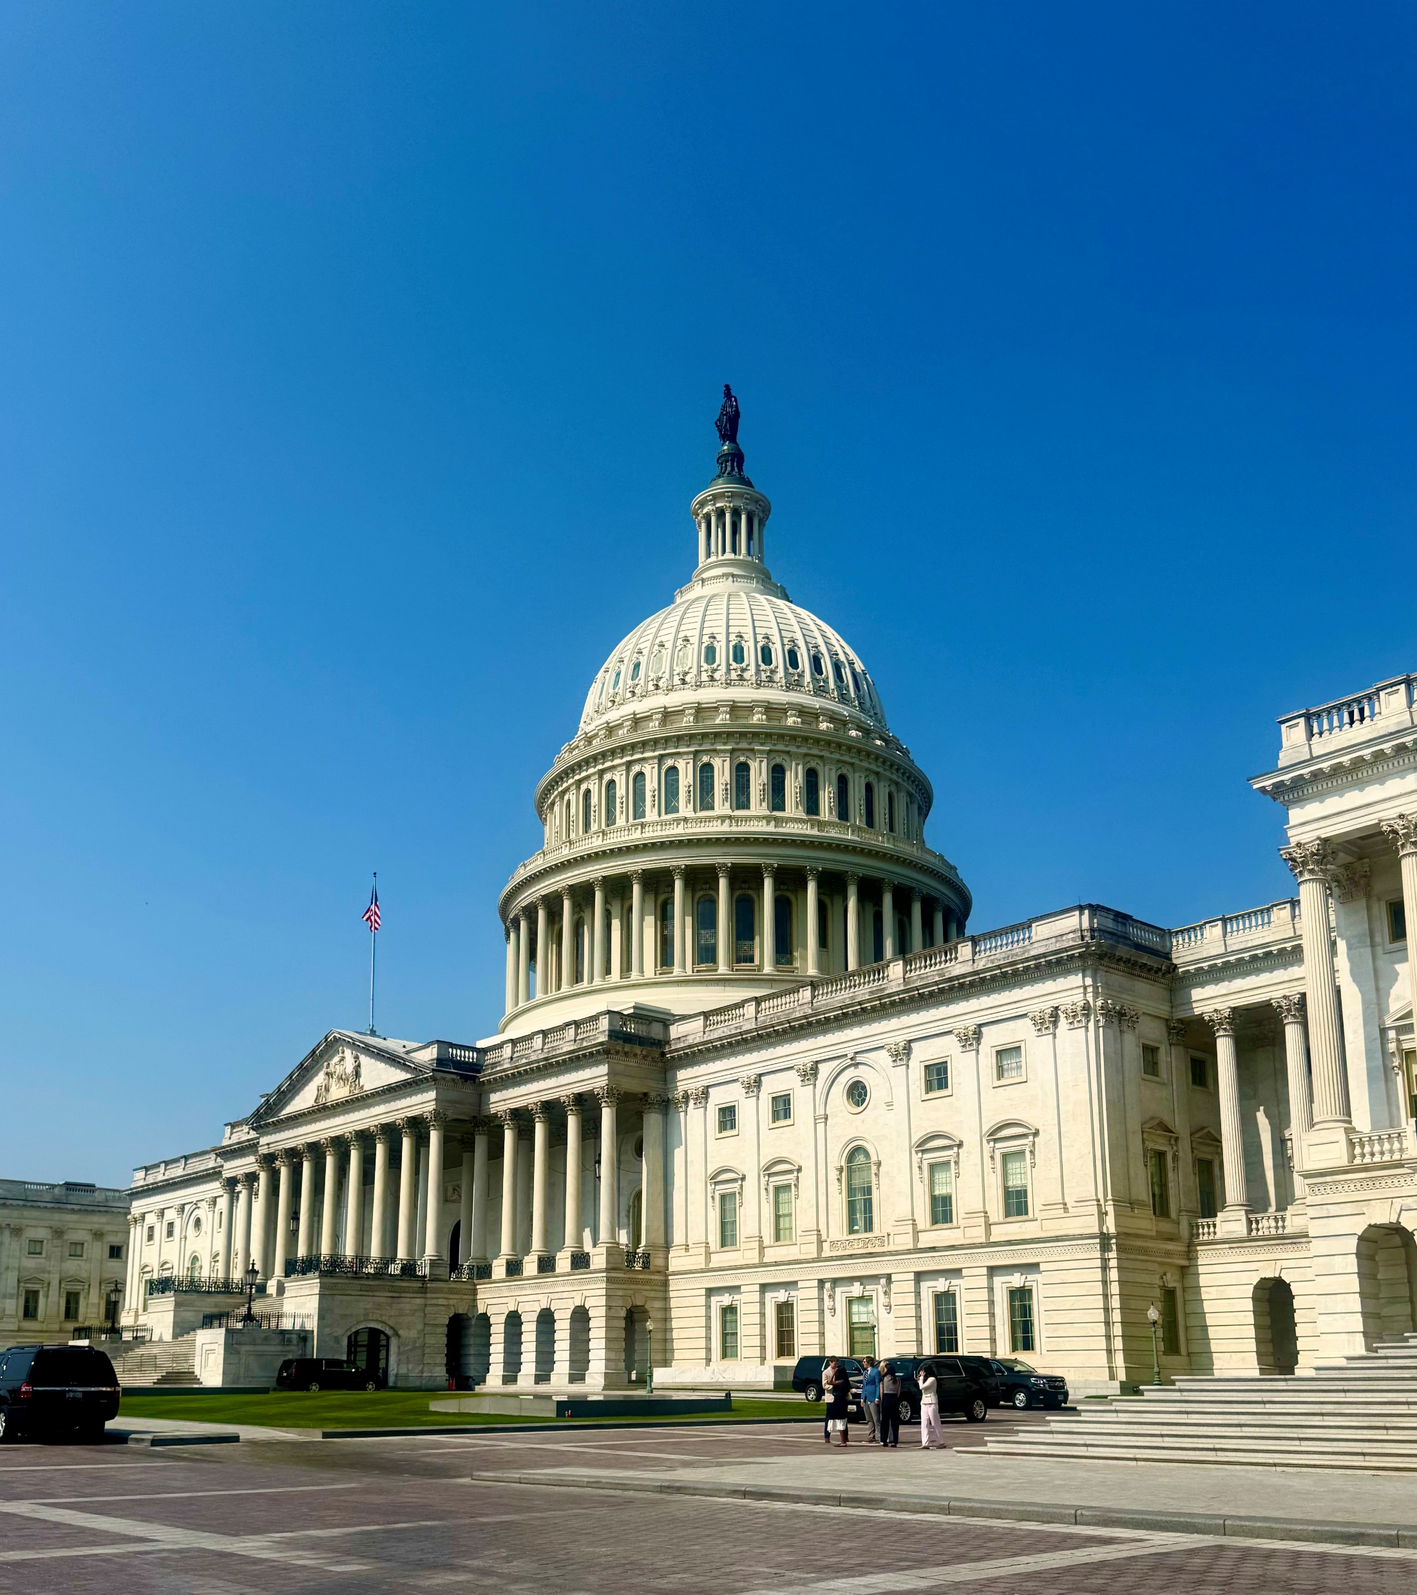
Protecting Patients’ Choice and Access to Vaccines
Vy Oxman (voxman@acponline.org)
Senior Associate, Legislative Affairs

Slide 2

ACP's 2026 Leadership Day
Protecting patients’ access to vaccines is one of ACP’s 2026 Policy Priorities.
For Leadership Day, we will be advocating for the Protecting Free Vaccines Act, H.R.5448/S.2857.
  ACP’s Letter of Support for the Protecting Free Vaccines Act
The Protecting Free Vaccines Act would protect patients’ choice by preserving access and coverage to vaccines backed by rigorous scientific standards.

Slide 3

Issue
ACP supports policies to preserve coverage for long-standing, safe, and effective vaccines, backed by evidence-based science.
Vaccines remain vital to our ability to mitigate diseases that threaten public health.
With the rise of vaccine hesitancy, through misinformation and disinformation, it is critical that physicians come together to protect patients by sharing their expertise and stories.
Notes:
It is ACP’s

Slide 4
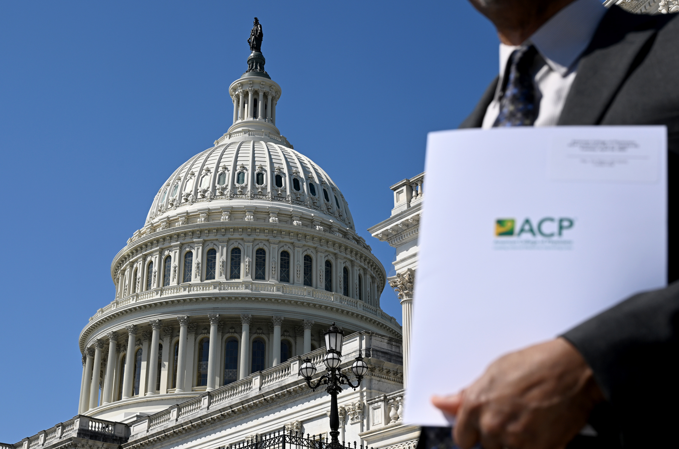
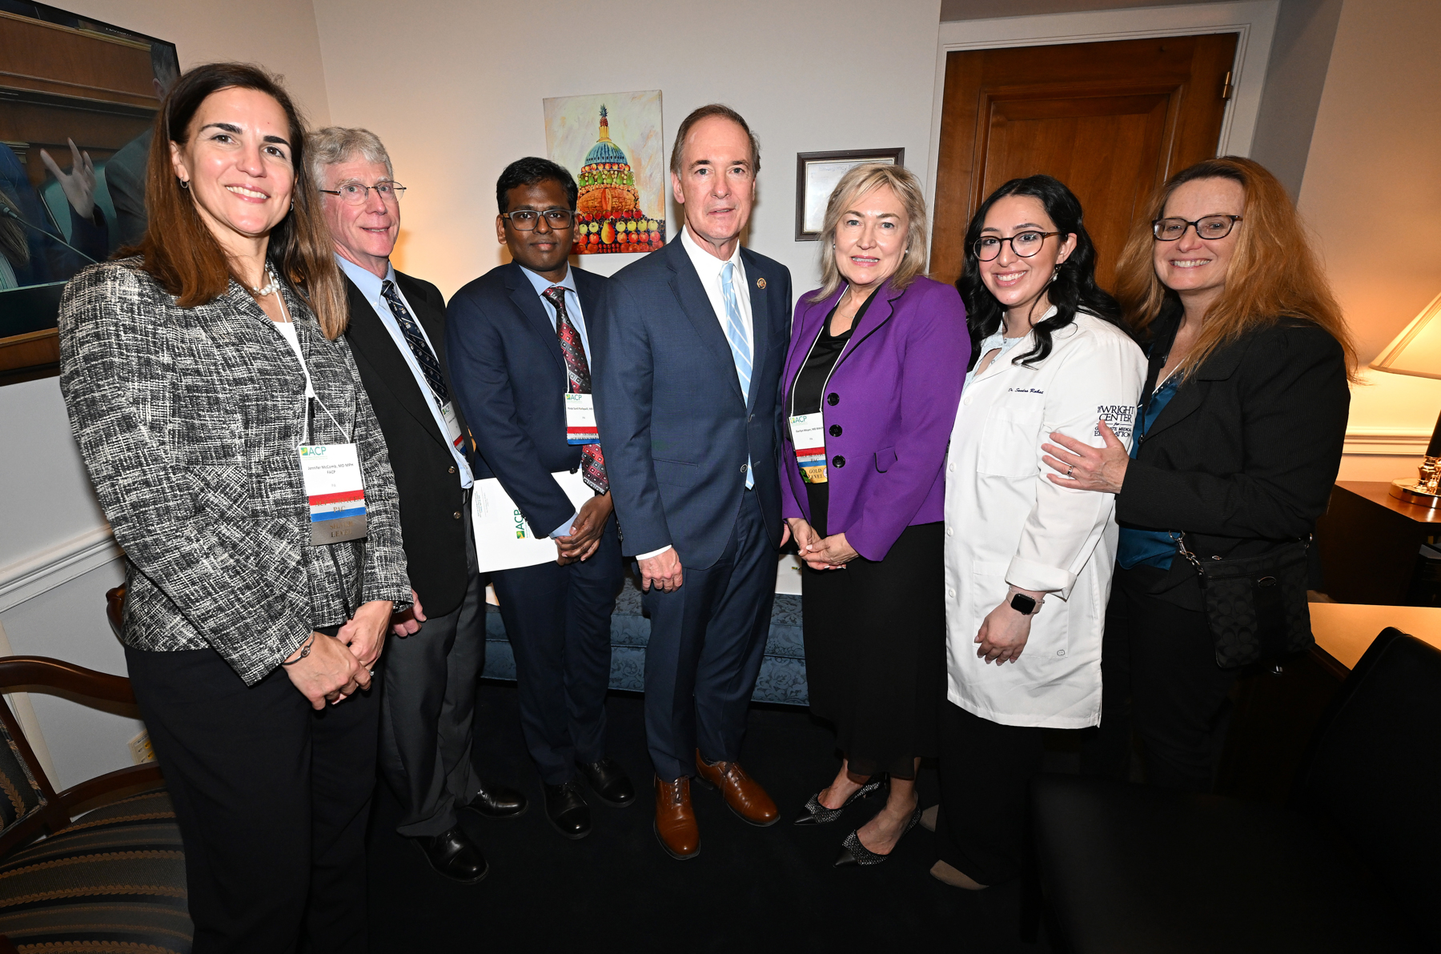
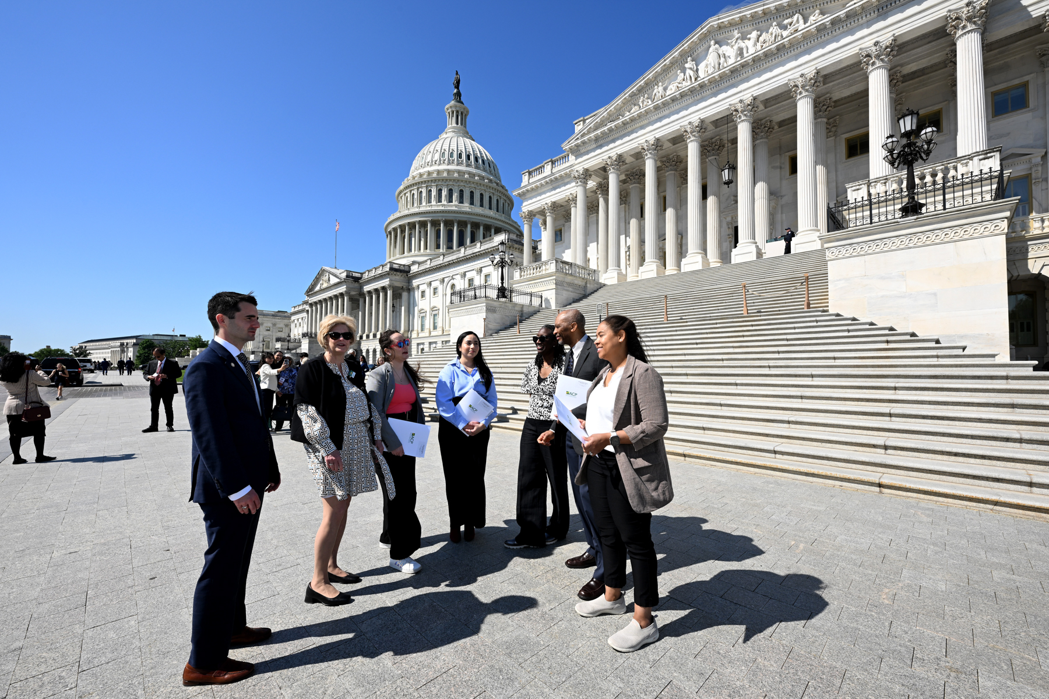
ACP’s Position on Vaccines
Vaccines remain one of the most important and cost-effective public health measures to combat communicable diseases. Without coverage, patients’ access to vaccines will be at risk, and immunization rates will drop.
ACP engages with lawmakers to protect and strengthen our nation’s public health by:
  supporting evidence-based guidance and research for vaccines,
  expanding access to safe and effective vaccines, and
  ensuring the public has reliable, accurate information to make informed decisions.

Slide 5
Why Action Is Needed
The Centers for Disease Control and Prevention (CDC) Advisory Committee on Immunization Practices (ACIP) recommendations play a key role in determining vaccine schedules.
By law, ACIP-recommended vaccines (adopted by the CDC Director) are covered by most health plans, including Medicare, Medicaid, the Children’s Health Insurance Program (CHIP), and private insurance, without patients having to pay out-of-pocket costs.
ACIP convenes and reviews evidence-based science for vaccine considerations
ACIP recommends vaccines for immunization schedules
Health plans are required to cover ACIP-recommended vaccines that the CDC Director adopts
Patients can discuss vaccine options with their doctors and get immunized for free

Slide 6
Why Action Is Needed
Recent arbitrary changes by the Department of Health and Human Services (HHS) to the ACIP panel and vaccine schedules have led to unnecessary confusion, further eroding the public’s trust in vaccines.
These changes put patients’ choice and health at risk.
HHS Secretary Kennedy fired and replaced all ACIP panelists in 2025
Changes made to vaccine schedules, not based on evidence-based science
Health plans are NO longer required to provide free coverage for vaccines removed from schedules
Patients can lose coverage for vaccines

Slide 7
Advocate for The Protecting Free Vaccines Act, H.R.5448/S.2857
The Protecting Free Vaccines Act, H.R.5448/S.2857
This bill would safeguard access to safe and effective vaccines by requiring that health plans offer zero-cost sharing for vaccines recommended by ACIP as of October 25, 2024, before recent changes were made to the ACIP panel and vaccine schedules.
This would ensure patients’ choice and access to long-standing, safe, and effective vaccines.
House Lead Co-sponsors: Representatives Frank Pallone Jr. (D-NJ-6), Richard Neal (D-MA-1), and Bobby Scott (D-VA-3)
Senate Lead Co-sponsors: Senators Ron Wyden (D-OR) and Bernie Sanders (I-VT)
For the full list of House co-sponsors, you can find it here.
The Senate currently does not have any additional co-sponsors for the bill.

Slide 8
Share Your Expertise and Stories with Lawmakers
As internal medicine physicians on the front lines of patient care, you understand the critical role vaccines play in mitigating the spread of preventable diseases.
When physicians speak, lawmakers listen. You have a unique perspective you can share, informed by your expertise and interactions with your patients/their constituents.
Share:
  Your experience with vaccine hesitancy and its impact on your work as a physician.
  What is evidence-based medicine, and why is it important in the context of vaccines and patient health.
  Patient stories. What happened to patients who refused vaccines? What happened to patients impacted by others who have refused vaccines?

Slide 9
Why Should Policy Makers Care?
For Republican Offices, focus on:
Patients’ choice and the physician-patient relationship
Cost-effectiveness of vaccines
National security threat
For Democratic Offices, focus on:
Coverage protections for vaccines, made possible by the Affordable Care Act (ACA)
Eroding the public’s trust in vaccines
Equity and access to vaccines

Slide 10

Call to Action
Leadership Day 2026
Ask your members of Congress to co-sponsor the Protecting Free Vaccines Act, H.R.5448/S.2857.
This bill would:
  Safeguard patients’ choice by ensuring that patients will have access to safe and effective vaccines, backed by rigorous scientific standards, with no cost-sharing.
  Vaccines recommended by ACIP as of October 25, 2024.
  Prevents coverage denials of vaccines removed from ACIP recommendations after October 25, 2024, effectively locking in coverage, without out-of-pocket costs to patients.

